Slide 1
Sexually Transmitted Infections
STIs 101 for Teens

Slide 2
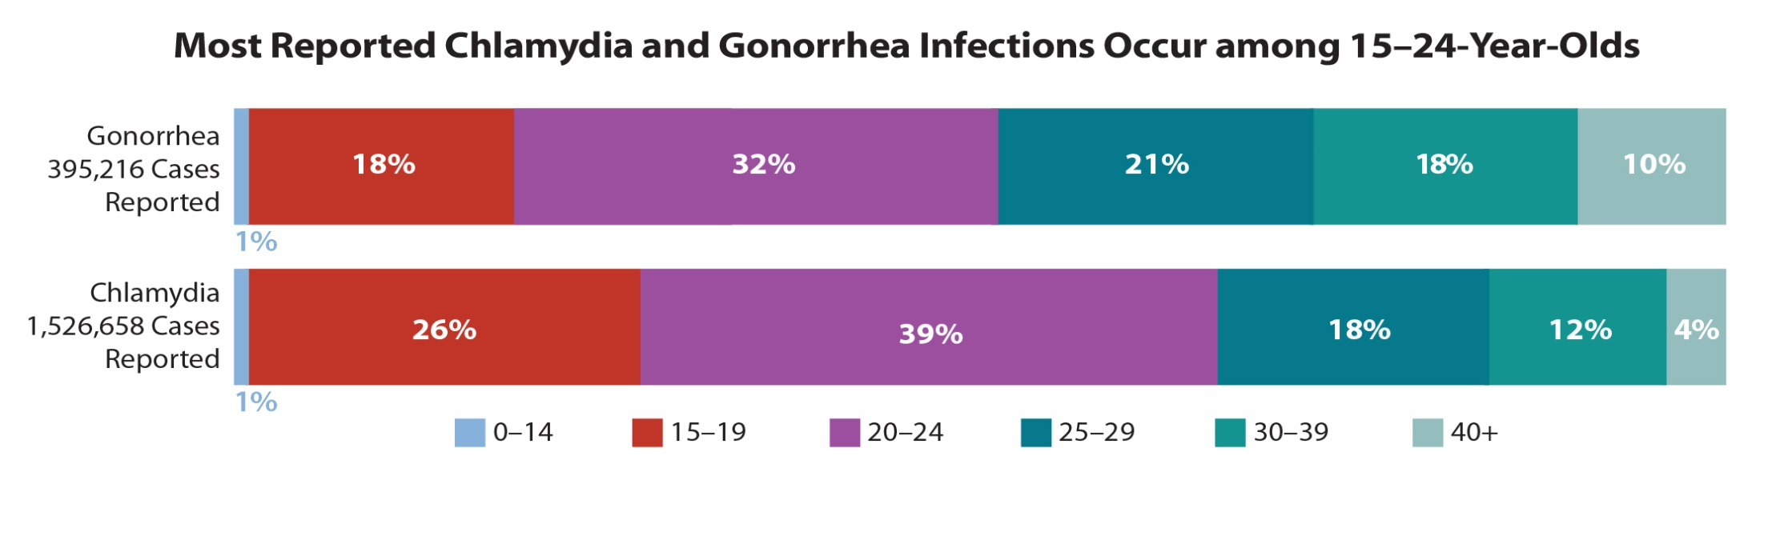
20 million new STIs occur every year in the US half among young people aged 15–24
Chlamydia: increase of 6% since 2014
Gonorrhea: increase of 13% since 2014
Notes:
Sources:
1. Centers for Disease Control and Prevention. Sexually Transmitted Disease Surveillance 2015. Atlanta: U.S. Department of Health and Human Services; 2016. Available at https://www.cdc.gov/std/stats.
2015 numbers

Slide 3
What STIs have you heard about?

Slide 4
The Major STIs
Treatable…but repeatable
Syphilis
Chlamydia
Gonorrhea
Trichomonas
Crabs (pubic lice)
Not curable...some life-long
Herpes
HPV (Human Papilloma Virus)
HIV (Human Immunodeficiency Virus)
Hepatitis B
Notes:
What do the diseases in green have in common? (Bacterial which are curable, but you can get infected again and again – they are Treatable but repeatable)
What do the diseases in red have in common? (Viruses – for which there is no medical cure – and some of these are life-long infections – herpes and HIV)
Why is Trichomoniasis a different color than the others? (Protozoa which are curable)
Why are “crabs” a different color? (Pubic lice are insects, “curable” by treatment)
The STIs in the right hand column (in red) are all viruses and are incurable – that is, they are not cured with medication.
The STIs in green, blue and purple are curable and “treatable but repeatable”.

Slide 5
Why teens have high rates of STIs:
The large number of 15-24 year olds infected with STIs increases the odds of meeting someone who already has an STI.
Can you tell who has an STI?
Notes:
What do the diseases in green have in common? (Bacterial which are curable, but you can get infected again and again – they are Treatable but repeatable)
What do the diseases in red have in common? (Viruses – for which there is no medical cure – and some of these are life-long infections – herpes and HIV)
Why is Trichomoniasis a different color than the others? (Protozoa which are curable)
Why are “crabs” a different color? (Pubic lice are insects, “curable” by treatment)
The STIs in the right hand column (in red) are all viruses and are incurable – that is, they are not cured with medication.
The STIs in green, blue and purple are curable and “treatable but repeatable”.

Slide 6
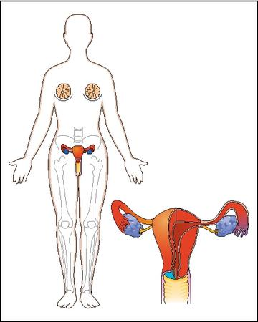
Why teens have high rates of STIs:
The cervix in
teen females has a weaker cell type that is easier to infect for some STIs
Female Reproductive Organs:
Uterus
Fallopian tube
Ovary
Cervix
Vagina
Notes:
The cervix is located at the end of the vaginal canal and is the opening to the uterus.
The cervix of a woman under 25 years old is still developing and is more likely to get infected if exposed to some STIs.
Teen girls are biologically more susceptible to some STI infections than older women (or women over the age of 25). The cervix in teen girls is still “growing”, changing, and maturing and is more susceptible to infection due to the presence of columnar cells on the outside of the cervix. As the transition zone (the line between the columnar and squamous cells) moves inward, into the cervical opening as the young woman ages, it makes the outer part of the cervix consist of squamous cells and is therefore more protected.

Slide 7
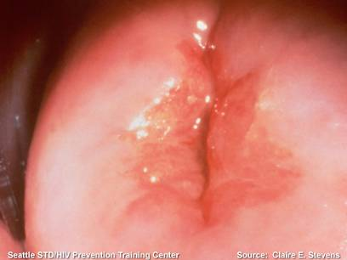
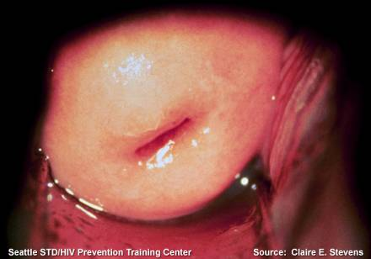
Why teens have high rates of STIs:
Unlike women over 25 years old,
a teen’s cervix has “weaker” cells
that are less protective against STIs.
“weaker” cells
“stronger” cells
Healthy Cervix: Young Woman
Healthy Cervix: Woman Over 25 yrs old
Notes:
The pictures compare the normal healthy cervix of female under 25 with that of a woman over 25.
Both pictures show a healthy cervix without STIs
However, the cells on the outside of the under 25 female are still developing and are weaker. This makes them more susceptible to Chlamydia, HPV and possibly HIV.
Are the participants surprised by the fact that young women are more likely to develop some STIs than women over age 25?
Ask participants: “Did you know this?”
The presence of these weaker cells (columnar cells) on the cervix makes females under 25 biologically more susceptible to STIs when exposed than older women. This makes it particularly important for teens to either delay having sex or make sure to use a condom during sex to protect the cervix.

Slide 8




Why teens have high rates of STIs:
Some teens are in relationships with older partners who often control their decisions.
Many people have trouble getting their partners to use condoms to prevent STIs or unwanted pregnancy.
Notes:
In some relationships, one person has more power than the other person. This can make it hard to talk about using condoms.
In relationships where one partner is older, this is particularly true.
Is it possible that the older partner has been with other people? Is it possible that they got an STI from a previous partner? Can you he now infect his new partner?

Slide 9
Myth Busters
What are the odds that a sexually active teen will get an STI this year?
1 out of 2
1 out of 5
c. 1 out of 4

Slide 10
What are the odds that a sexually active teen will get an STI this year?
1 of every 4 sexually active teens in California will get an STI this year...
...which is about 375,000 teens getting an STI this year!
Notes:
Did the participants guess correctly?
Were they surprised by the number?

Slide 11

375,000 STI-infected CA teens will fill a football stadium over 4 times!!
Notes:
The purpose of this slide is to increase the perception of susceptibility regarding the chances of STI infection for those who are – or will be - sexually active.
This picture and number comes from the capacity of the Rose Bowl.

Slide 12
Myth Busters 1, 2
STIs usually happen to people who are not “clean.”
FALSE
  One out of every four sexually active teens will get an STI this year.
TRUE
Notes:
STIs usually happen to people who aren’t “clean”: STI transmission has nothing to do with “cleanliness” or hygiene. STIs are caused by germs (virus, bacteria, protozoa) which are often on, in, and under cells and membrane surfaces – they can’t be washed off.
One of every four sexually active teens will get an STI this year: TRUE As covered previously, 1 out of 4 sexually active 15-19 year olds in California means approximately 375,000 teens getting a new STI infection every year. The 1:4 odds is an average for all teens having sex – including those who have sex only once and those who have sex several times within a year. The more sex partners a person has within a year, the more the odds increase for getting infected with an STI.

Slide 13
How serious are STIs?

Slide 14
Medical Complications of Untreated STIs
STIs can result in:
Cancer
AIDS (from sexually transmitted HIV)
Death
Notes:
Key points:
STIs can cause cancers, AIDS and death in both genders.
If you have time, ask participants: “What can happen to a person who gets a STI and doesn’t get treatment?”
If you have time, ask participants: “How would it affect their life?”

Slide 15

Medical Complications of Untreated STIs
If a young girl or woman gets an STI, and is untreated or undertreated she could end up with:
- Pelvic Inflammatory Disease (PID)
- Cervical cancer
- Infertility (inability to have babies)
Notes:
Key point:
PID is a condition that can occur when a woman has untreated Chlamydia or gonorrhea. It can also cause chronic pain.
Annual pap tests are important because they screen for cervical cancer.
Chlamydia and gonorrhea can result in infertility if left untreated.

Slide 16


Medical Complications of Untreated STIs
If a pregnant woman has an STI, her baby could end up with:
Infections
Birth defects
Stillbirth (born dead)
Notes:
Key points:
If a pregnant woman has an STi, her baby could end up with an infection, birth defect and or be stillborn
In case you are asked…
Chlamydia and gonorrhea can infect a newborn’s eyes during birth if the mother is infected and has not been treated.
Chlamydia can infect the nasal passages during birth if the mother is infected with Chlamydia. This infection can spread to the baby’s lungs resulting in pneumonia.
Herpes can enter a baby’s eyes during birth, move along the ocular nerve into the brain, causing inflammation of the lining of the brain (encephalitis) which can result in death.
Syphilis can cross the placenta during fetal development and infect many tissues in the developing fetus, including the brain. Sometimes the damage is so severe that the baby is stillborn.
HIV, herpes, and Hepatitis B and C can cause life-long chronic infections for newborns.

Slide 17

STIs increase the chances
for giving and getting HIV
by 3 – 5 Times!!
Open sores are open doors!
Notes:
Often we think of HIV as the most severe STI. It is important to note that having OTHER STIs can increase the chance of giving and getting HIV if exposed. This is another important reason that sexually active persons should get regularly tested for STIs.
Syphilis and herpes sores (lesions) are open doors for HIV to enter the body or exit the body.
All STI infections trigger an immune response that results in a great increase in white blood cells at the site of infection. Although these white blood cells actually are fighting the STI infection, they also are the target cells for HIV.
STI infection results in more target cells for HIV to infect at the site of an STI infection – significantly increasing the chances for HIV infection to occur IF the person with the STI is exposed to HIV.
If a person with HIV also gets infected with an STI, that person is more likely to transmit HIV to a sex partner if the STI goes untreated.
When the immune system “activates” white blood cell production (to fight the STI), it may also stimulate HIV-infected white blood cells to replicate themselves. Many of the newly produced white blood cells will also be HIV infected – and many of those cells will release HIV into the blood, semen, or vaginal secretions of the infected person. This makes this dually-infected person much more infectious to others for HIV.

Slide 18
Myth Busters –
3, 4, 5
Herpes and HIV are incurable life-long infections.
TRUE
Several STIs increase the chances for HIV transmission and HIV infection.
TRUE
Infections, birth defects, and stillbirth can result from STIs.
TRUE
Notes:
Herpes and HIV are incurable life-long infections: TRUE The human immune system is not able to rid the body of either herpes or HIV. That means that all people infected with herpes and HIV are capable of transmitting these viruses to others throughout their lives – even if they have no signs or symptoms.
There are treatments that can help with the symptoms of herpes and HIV; the treatments can also reduce the chances of spreading the infection to other people.
There are vaccines for HPV and Hepatitis B so these can be prevented if the vaccine is administered prior to infection by these two STIs.
Several STIs increase the chances for HIV transmission and HIV infection: TRUE
Herpes, trichomoniasis (“Trich”), Chlamydia, gonorrhea, and syphilis all increase the chances for getting and giving HIV by as much as five times. This is due to the increase in white blood cells at the site of STI infections (remember, HIV invades and multiplies inside white blood cells) and because these STIs can make it easier for HIV to reach the white blood cells.
Infections, birth defects, still birth can result from STIs: TRUE
Infertility and chronic pain can be a consequence of pelvic inflammatory disease (PID). PID can be the result of untreated Chlamydia or gonorrhea infections in women.
Birth defects can occur when a developing fetus gets syphilis from its pregnant mother
Still birth a baby can be born dead as a result of the mother having an STI like syphilis

Slide 19
How are STIs transmitted?
Notes:
Key Points:
Transmission is divided into two main categories: fluids and direct contact.
It’s important to remember that there are multiple modes of transmission of STIs. We cannot assume that there is only fluid-based transmission without skin-to-skin contact.
The best way to avoid STIs is to abstain from risk behaviors or use a condom.
Avoid getting too detailed about the modes of transmission to avoid uncommon “what if” scenarios. It is better to stick to the main modes that include the types of fluids exchanged or the touching of body parts (i.e. genitals, mouth and other mucous membranes)

Slide 20
STI Transmission
Transfer of STI fluids such as:
Vaginal fluids
Pre-ejaculate
Semen
Abnormal discharge (or pus)
Blood
Anal fluids
through oral, anal, vaginal sex
STI organisms can be passed even when
there are no signs or symptoms present!
Notes:
Fluids include:
Vaginal fluids: what comes out of women
Pre-ejaculate: what comes out of a man
Semen: what comes out of a man
Discharge (i.e. pus from an infection): what comes out of men & women
Blood: from men & women
STI transmission simplified into two main categories:
Exchange of infected fluids
Direct contact through naked genital to genital rubbing.
Exchange of infected sexual fluids (i.e. vaginal fluids, semen, and possibly pre-semen):
STIs transmitted through blood are HIV, Hep B, and Hep C.
STIs transmitted through semen, vaginal fluids, or infectious discharge (pus) are Trichomonas, Chlamydia, gonorrhea, HIV, and Hep B.
HIV and Hep B may also be transmitted via pre-semen.
It’s incredibly difficult to separate transmission that occurs with fluid exchange and that which occurs with naked genital to genital rubbing; sex with fluids very often involves skin contact as well.

Slide 21

STI Transmission
STIs can also be passed through direct contact with an STI sore or infected tissue
through oral, anal, vaginal sex…and frottage
FROTTAGE: French for naked genital to genital rubbing!
Notes:
Direct contact with open sore or infected tissue:
The common direct contact STIs are HPV, herpes, and syphilis.
Direct contact can be oral, anal, vaginal sex as well as intimate sexual activities that involve intimate sexual rubbing or grinding – sometimes called “dry humping”.
Infected tissue or skin is not always visible; herpes is often transmitted when there are no visible signs or symptoms while the virus is shedding from the skin.

Slide 22
How do you prevent STIs?
Notes:
Key points:
Prevention implies the elimination of all risk. The only way to guarantee removal of all risk is to not have intimate sexual contact, also known as sexual abstinence.
Risk reduction is about lowering the chances of STI/HIV transmission.

Slide 23
How you can protect yourself:
Not having sex (oral, anal, vaginal) is the only sure way to avoid STIs.
Not having sex (oral, anal, vaginal) is the only sure way to avoid STIs.
Notes:
Key Points
Abstinence is the only way to truly prevent STIs; everything else is risk reduction (there are some risks).
About half of all high school students have never had intimate sexual contact; many teens are choosing abstinence.
If you have time, you could ask “What does ‘abstinence’ mean to you?” “Is sexual abstinence a realistic option for teenagers?

Slide 24





How you can protect yourself:
Talk to your partner about STIs
and agree to protect yourselves
If or when you have sex.
Notes:
Key Points
Point out that this option works if partners have good communication skills, equal power in the relationship, and a basic level of shared trust and honesty.
Talking about sex and relationships is a SKILL and it has to be practiced.

Slide 25

How you can protect yourself:
3) If you choose to have sex - use latex (or polyurethane if allergic to latex) condoms correctly each time for oral, anal, vaginal sex.
Quick Fact:
Male and female condoms reduce – but don’t eliminate - the chances of STI transmission.
This is because some STIs might infect areas not covered by a condom.
Notes:
Key points
Ask the group “When would you suggest that someone talk about protection from STIs with a sexual partner?” (Answer should be BEFORE getting in a sexual situation).
Being under the influence of drugs or alcohol can affect sexual decision making; sex under the influence can prevent someone from using condoms correctly (or at all).
DEMONSTRATE proper condom use if allowed (see appendix for activities).

Slide 26
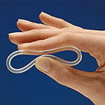

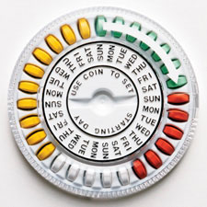
How you can protect yourself:
Quick Fact:
Birth control pills, the Shot,
the Ring, or the Patch
do not protect against STIs.
Notes:
Key points
Hormonal contraceptive methods (the Pill, the Patch and the Shot) DO NOT provide ANY protection against STIs.
If someone decides to have sex, they should use condoms in addition to any hormonal contraception for STI and pregnancy prevention.
Some teens have sex with people of the same gender; they may not be at risk for pregnancy but they are still at risk of acquiring and transmitting STIs.
Many people think that pregnancy prevention equates STI prevention; this is not the case. Condoms are the only method which provides both types of protection. Hormonal birth control alone offers no protection against STIs.

Slide 27

How you can protect yourself:
4) If you are going to have sex, it’s safer to have sex with only one partner, who has sex only with you – and who doesn’t have
an STI infection.
Notes:
Key points
People in a sexual partnership who only have one partner have reduced the risk of getting an STI. The risk is further reduced if their partner has no other partners.
If you have time, you can ask “Realistically, how would you know for sure that your partner does not have an STI infection—or another sex partner?”
Getting tested with a partner is important to prevent infection.

Slide 28
But…even if you have unprotected sex with just one person…you can’t really know about his/her sex partners…
or their sex partners – or the STIs that could be passed to you.
You
Notes:
This slide replicates a sexual network. It shows that even someone in a monogamous relationship (“you”) can be exposed to a whole sexual network through one single partner.
Anyone who is a color other than light blue is infected with an STI.
This slide should be used to reaffirm the need for risk-reduction methods (i.e. male or female condoms) as well as testing for STIs, even within monogamous partnerships.
In the diagram above, the solid arrows represent transmission of an STI between sex partners. The dotted lines indicate sexual contact – but no STI transmission. Anyone who has a color other than light blue (yellow, red, brown) is infected with an STI. Notice that some people with STIs do not always transmit the STI to a sex partner with each sexual encounter – but clearly the more often one is exposed to a partner with an STI, the more likely that he/she will get infected.

Slide 29

How you can protect yourself:
5) Avoid sex-under-the-influence (SUI) of alcohol and other drugs.
6) Do not use needles – to
shoot up.
7) If you have sex, get tested for STIs at least once a year.
Notes:
Sex under the influence, like driving under the influence, is a risky behavior
Most teens understand (and/or have witnessed) how being under the influence can lead to risky sexual behaviors and unhealthy outcomes such as black outs and date rape.
Ask participants “Why does sex under the influence (SUI) increase ones’ risk of getting or spreading STIs?”

Slide 30
Myth Busters – 6, 7, 8
Sex occurs only when there is penis-in-vagina contact.
FALSE
The birth control pill and patch help lower the chance of getting an STI.
FALSE
Correct use of condoms reduces, but does not eliminate the chance for STI transmission.
TRUE
Notes:
“SEX” occurs only when there is penis-in-vagina contact: FALSE There are many definitions of “sex” and “sexual activity”. Don’t be trapped into defining sex. You will notice in this slide show we use the phrase “intimate sexual activity” – which includes anal, vaginal, oral sex, – and skin-to-skin rubbing of sex organs or genital regions.
It is important for teens to know that some STIs (herpes and syphilis) can be transmitted by all types of oral sex (fellatio, cunnilingus, analingus). Further, direct contact STIs (herpes, HPV, syphilis) can also be passed by skin-to-skin rubbing of the genitals or the genital regions. So even though some people would not define naked genital to genital rubbing as “sex”, some STIs are transmitted through this kind of sexual expression. This is why we use the phrase “intimate sexual activity.”
The birth control pill and patch help lower the chances of getting an STI: FALSE NONE of the hormonal methods of contraception (the pill, the shot, the patch, the ring) lower the chances of STI infection. The only method of pregnancy prevention that can significantly lower the risk of STI acquisition is the condom. This is why family planning clinics strongly suggest that teens use condoms along with their chosen method of birth control – so that they are protected against unwanted pregnancy and STI infection.
Correct use of latex condoms reduces, but does not eliminate, the chance for STI transmission: TRUE No STI organisms can pass through a latex condom. However while latex condoms are very good for blocking the transmission of fluid-based STIs (such as Chlamydia, gonorrhea, Trich, HIV), they cannot protect sex partners from STI infections that occur on tissue or skin not covered by the condom. Sometimes herpes, HPV, or syphilis infections will occur in areas on a male not covered by a condom (i.e., the scrotum or at the very base of the penis). So, while using condoms properly and consistently greatly reduces the chances for STI transmission, they do not eliminate the chances. Correct and consistent use of condoms is “safer” sex, not “safe” sex.

Slide 31
How would you know if you have an STI?

Slide 32
Most people with STI infections have
NO signs or symptoms!!
However, if symptoms are present around your genitals, they may include:
  Warts, blisters or sores
  Itching, burning or pain
  Abnormal bleeding or discharge (pus)
You can’t tell by looking if
someone is infected or not!!
Warning…pictures ahead!!
Notes:
Key points
It is VERY common for a person with an STI to have NO signs or symptoms-including males. It is a common myth that males “will always know” if they have an STI because they will have pain, burning, itching or discharge but this is not true.
Getting examined by a health care provider is the only way to know for sure.

Slide 33
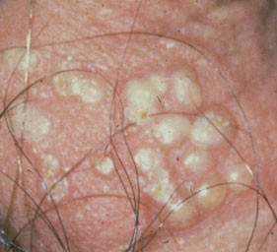
Herpes Blisters
Open sores are
open doors
for HIV to
enter or exit
the body.
Seattle STD/HIV Prevention Training Center
Source: University of Washington
Notes:
This is an example of the blisters of herpes – probably from the initial outbreak. These blisters will soon erode into painful open sores. The sore will go away after a few days, but will likely reappear again periodically. Herpes is a life-time infection. There is no cure.

Slide 34
Caution…
Most people with herpes
don’t know they are infected
because their symptoms
are mild or absent!!
Many have NO or only minimal signs or symptoms, sometimes only one or more blisters.
Notes:
Herpes is often spread during “asymptomatic viral shedding” which means that the virus is released from the skin without any symptoms.
Many have No or minimal signs or symptoms, sometimes only one or more blisters.

Slide 35
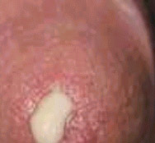
Infectious discharge
of gonorrhea from a male
Seattle STD/HIV Prevention Training Center
Source: University of Washington
Notes:
When gonorrhea or Chlamydia cause symptoms in males, the infectious discharge shown in this slide is the typical sign. This discharge is NOT semen or ejaculate. The discharge is full of pus, infectious microorganisms, and the contents of dead cells, and is highly infectious. So, the notion that STIs such as gonorrhea or Chlamydia require ejaculation for transmission to occur is NOT true

Slide 36
Caution…
About half of all males
with Gonorrhea or Chlamydia
will NOT have signs or symptoms
such as abnormal discharge or painful urination.
Notes:
Males commonly believe the myth that they “will always know” when they have an STI. This is not true.
“No signs” means nothing that can be seen – such as a visible discharge, rash, blisters, or sores.
“No symptom” means not having any pain or sensations (like burning on urination) associated with an STI infection.

Slide 37
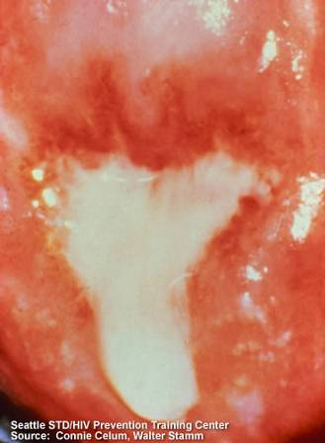
Infectious discharge from the cervix of a female with chlamydia
Notes:
Women may notice that they have a natural, healthy discharge from the vagina. The amount and nature of this normal discharge will vary from person to person. However, this slide shows infectious discharge from a Chlamydial infection on the cervical os (opening). A woman may or may not notice a difference from her natural discharge.

Slide 38
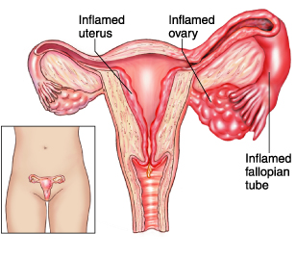
Caution…
Young women who have Gonorrhea or Chlamydia without any signs or symptoms can still develop PID
About 4 of 5 females with Chlamydia will NOT have
any signs or symptoms.
Notes:
Image compliments of Reed Group. Introduction and Appendix. The Medical Disability Advisor. 5th ed. Ed. Presley Reed, MD. Westminster: CO, 2005. Online at: http://www.mdguidelines.com/pelvic-inflammatory-disease/definition
The drawing shows a cervix with PID as a result of chlamydia infection. PID is a serious infection of the upper reproductive system (fallopian tubes and/or ovaries). PID can be a “silent infection” without any signs or symptoms.
The severity of this is reinforced when you point out that 4 out of 5 females with gonorrhea or chlamydia have no signs or symptoms.

Slide 39
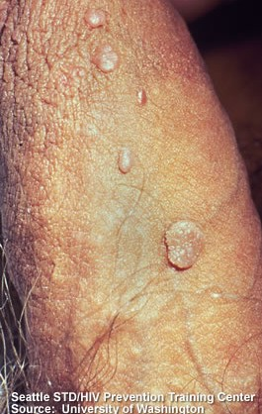
Genital Warts
Notes:
Most people with HPV do not ever get genital warts. The warts in this photo are much more typical of genital wart infections than the “horror” photos of extremely unusual warts that tend to show up in clinical slide sets of STIs.
Genital warts can be removed, however, removal of the wart does not mean that the underlying HPV infection has been eliminated. About half of the time the warts will grow back

Slide 40

Most people with HPV do NOT have the virus types that cause visible warts.
Notes:
The types of genital HPV associated with cervical and anal cancer do not cause warts. Unfortunately, the most serious strains of HPV – the ones associated with cervical cancer in women – rarely manifest as visible warts. This is why it is so important for females who have ever had sex to get Pap tests done on a regular basis.

Slide 41
Remember: Even when no signs or symptoms are present...
...STIs can still be transmitted
...STI consequences like infertility or cervical cancer can still occur.

Slide 42
Attention!!
Anyone who has an STI should not try to treat themselves.
They should not borrow medicine or use any left-over medications.
Instead, they should go to a doctor or clinic for the appropriate tests and only take medications prescribed.
Notes:
Self-treatment (that is, taking medication not prescribed by a medical provider specifically for the STI infection) never works and could be extremely dangerous – this includes buying something over the counter (i.e. yeast infection medication – but using it for an STI infection), borrowing medicines from others or using old or left-over medication

Slide 43

Key STI Facts for Teens
If you get an STI - ALL sex partners should be informed that they might have an STI – even if
they have no symptoms.
Reinfection by untreated partners is common.
Notes:
There are three reasons for informing sex partners they may be infected:
Infected partners may not know they have an STI, and they could spread it to others;
Infected partners who don’t know they have an STI could suffer serious consequences if they do not receive proper treatment;
Infected partners who don’t know they have an STI often will give the STI back to their partner even if that partner has been treated. (Even after treatment, re-infection with the same STI is VERY common!)

Slide 44




Key STI Facts for Teens
There is no single test for all STIs, so be sure to ask which STI tests are being done.
Notes:
Each STI has it own specific test(s) and, most doctors do not test for everything.
Sometimes tests for certain STIs cannot be done (i.e. no approved test for HPV in males). Talking with a medical provider about which tests are being done and why they are being done is important.
It might be helpful to mention that the test for some STIs is a simple, painless urine sample.

Slide 45

Minor Consent for Sexual Health Care Services
Anyone 12 years old or older can be tested and treated for STI infections and get birth control without permission from parents or guardians…
CA Family Code 6926 (a)
Healthcare providers cannot notify parents or guardians when minors get these sexual health services.
Notes:
All medical providers and their staff are required by law to preserve the confidentiality of their patients. That means they cannot reveal any private information to anyone (other than public health authorities), including to parents/guardians, that could identify an individual patient or the reason for their clinical visit or treatment.
SOURCE: California Family Code 6926:
“A minor who is 12 years old or older and who may have come into contact with an infectious, contagious, or communicable disease may consent to medical care related to the diagnosis or treatment of the disease, if the disease … is a related sexually transmitted disease …”

Slide 46
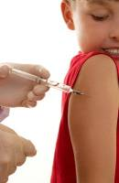
HPV Vaccine
✓ A vaccine to prevent some types of HPV.
✓ Recommended for girls & boys11-12 years old,
up to age 26 and as young as 9.
Best if given before first sexual contact
Discuss with your parents/doctor.
HPV vaccination is cancer prevention
Hepatitis B vaccine
Notes:
Teens in CA do not need to get parental permission to get the HPV vaccine; it is now considered a confidential sexual reproductive health service (California Family Code Section 6926). Boys have been approved to receive the vaccine as well.
Those who have gotten the vaccine should continue to get STI testing and Pap tests (for females only).
Gardasil protects against 4 HPV types that cause about 70% of cervical cancer and 90% of genital warts
Gardasil has been shown to be 100% effective in clinical trials
Gardasil is recommended for girls & boys 11-12 years old (approved for up to 26 and as young as 9) for the prevention of genital warts as well as cervical, vulvar, vaginal cancer in females and anal cancer in both females and males.
Another FDA approved HPV vaccine available as of October, 2009 is Cervarix for females 10-25 years old to prevent against 2 HPV types that cause 70% of cervical cancer/Cervarix is 93% effective in clinical trials
FROM CDC:
Dosage and Schedule
•CDC recommends routine vaccination of girls and boys at ages 11 or 12.
•The vaccination series can be started at age 9 years
•HPV vaccines are administered as a 2-dose series (0, 6-12 months) for most persons who initiate vaccination at ages 9 through 14 years, and a 3-dose series (0, 1-2, 6 months) for persons who initiate at ages 15 through 26 years, and for immunocompromised persons.
FROM the American Cancer Society website:
HPV Vaccine: Facts and Fears
Vaccines to prevent human papilloma virus (HPV) infections are safe and effective. They can protect girls and boys from getting several different types of cancer when they get older. The American Cancer Society recommends the vaccine as one way to keep more people from getting cancer. HPV vaccines protect against high-risk types of the virus that cause most cervical cancers. The virus is also linked to cancers of the vulva, vagina, penis, anus, and throat. HPV vaccination is cancer prevention.

Slide 47
HIV 101
No cure
exists for
HIV and AIDS

Slide 48

Living with HIV
Antiretroviral Therapy (ART) uses different kinds of medication to keep HIV from growing & multiplying
Helps a person with HIV have a normal life expectancy
Lowers their risk of developing
non-HIV-related illnesses
Reduces the chances of passing
HIV to others
Notes:
Today, an estimated 1.2 million people are living with HIV in the United States. Thanks to better treatments, people with HIV are now living longer—and with a better quality of life—than ever before. If you are living with HIV, it's important to make choices that keep you healthy and protect others.
You should start medical care and begin HIV treatment as soon as you are diagnosed with HIV. Taking medicine to treat HIV, called antiretroviral therapy or ART, is recommended for all people with HIV. Taking medicine to treat HIV slows the progression of HIV and helps protect your immune system. The medicine can keep you healthy for many years and greatly reduces your chance of transmitting HIV to sex partners if taken the right way, every day.
If you’re taking medicine to treat HIV, visit your health care provider regularly and always take your medicine as directed to keep your viral load (the amount of HIV in the blood and elsewhere in the body) as low as possible.

Slide 49
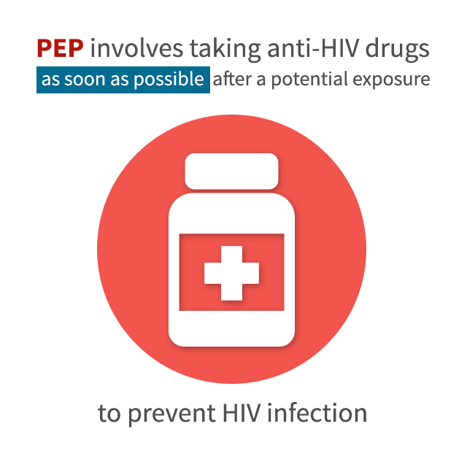
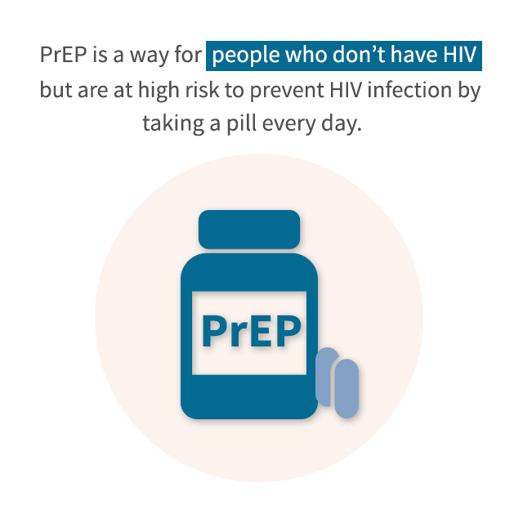
Medications to
Prevent HIV
Notes:
Post Exposure Prophylaxis (PEP):
Must be taken within 72 hours of potential exposure to material infected with HIV
Not 100% effective
2-3 anti-virals for 28 days
Pre Exposure Prophylaxis (PrEP):
For people who are HIV – and are at substantial risk of contracting HIV
*Ex. HIV+ partner, has sex with partners who are at risk for HIV, IV drug user and shares equipment( aka works)
*It is important that a person still use protection during sexual intercourse / new needles

Slide 50
Myth Busters – 9, 10, 11
People with STIs usually will feel some kind of pain or see some sign of infection.
FALSE
STIs are passed by intimate sexual contact (vaginal, anal, oral) between partners.
TRUE
The chance of passing STIs through oral sex is very low.
FALSE
Notes:
People with STIs usually will feel some kind of pain or see some sign of infection: It is much more common for people with STIs to NOT see or feel anything that would indicate an STI infection. This is true for both males and females, even though a common myth is that males will “know” they have an STI.
STIs are passed by intimate sexual contact (vaginal, anal, oral) between partners. TRUE STIs ARE passed by intimate sexual contact – meaning oral, anal, and vaginal sexual activities. This includes vaginal sex, anal sex, oral sex (mouth to penis, mouth to vulva, mouth to anus) and naked genital to genital rubbing.
The chance of passing STIs through oral sex is very low: FALSE Direct contact STIs (syphilis, herpes, HPV) are transmitted by oral sex – fellatio (mouth and penis), cunnilingus (mouth and vulva/vagina), analingus (mouth and anus). Gonorrhea can be transmitted by fellatio (penis-to-mouth or mouth-to-penis).

Slide 51
Myth Busters – 12, 13
STIs are commonly transmitted even when no sign or symptoms are present.
TRUE
Abstinence means not having vaginal sex.
FALSE
Notes:
STIs are commonly transmitted even when no signs or symptoms are present: TRUE Most STIs are transmitted in the complete absence of signs or symptoms (sores, blisters, discharge, pain, burning on urination, etc); this is quite common for Chlamydia, gonorrhea, herpes, HPV, HIV, and Hepatitis B. Many STI experts believe that most new genital herpes infections are transmitted in the absence of symptoms. About 90% of people with genital herpes do not know that they have it.
Abstinence means not having vaginal sex: FALSE Technically, abstinence means “refraining from a practice or behavior” and can be applied to any behavior – such as abstinence from alcohol, sex, gambling, watching TV, or eating fried foods. People use this term in many different ways – and it is important to ask them to DEFINE their terms. For some people, sexual abstinence may mean only not having vaginal or anal intercourse (vs. rubbing genitals and/or oral sex); for others sexual abstinence may mean not having any type of sexual physical contact other than kissing.

Slide 52
Myth Busters 14
What two STIs have vaccines?
1. HPV
2. Hep B
Notes:
ACTIVITY SHEET QUESTION 14

Slide 53

STIs- 15
Your local health center for STI tests:
Planned Parenthood
1-888-743-7526 (PLAN)
www.planned.org
Notes:
ACTIVITY SHEET QUESTION 15

Slide 54
Tips during a visit
Let receptionist know you want Confidential services
  …if you do not want your parent/guardian to know
For insurance ask for Family Pact or “green card” as your insurance
Bring your school ID
  …it is not necessary, they just want to know you are who you say you are
Have a confidential phone number for contact
  ….staff need to be able to deliver a message or text appointment reminder
Know your home address
  ….this is necessary for future appointments--nothing will be mailed to your home.

