Slide 1
Notes Pg#85 & 86: Endangered Species
EQ: What’s happening to global biodiversity and why should we care?
Write the phrases in RED

Slide 2
Biodiversity
What does “Bio” mean?
Life
Bio =

Slide 3
Biodiversity
What does “Diversity” mean?
Diversity = Variety

Slide 4
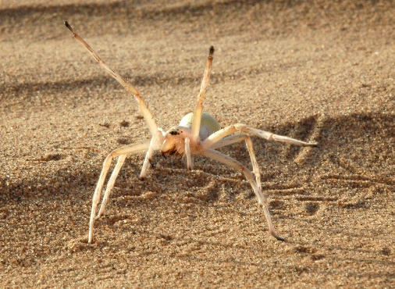
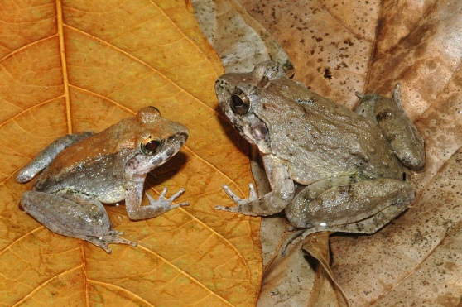
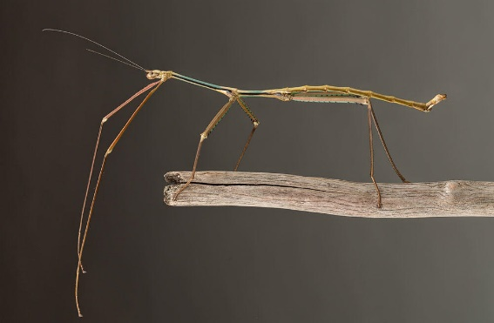
Biodiversity is the variety of life on Earth and the essential interdependence of all living things
Scientists have identified more than 2 million species. Tens of millions remain unknown and new species are discovered every year.
The tremendous variety of life on Earth is made possible by complex interactions among all living things including microscopic species like algae and mites.

Slide 5
Why is Genetic Diversity Important?
A healthy population has a high genetic diversity
Allows populations to survive diseases, changes in climate or other local environmental conditions
Provides a basis for evolution via natural selection

Slide 6
Genetic Diversity Examples
Northern Elephant Seals:
Hunted down to 20 in 1890s
Rebounded to 30,000 but not genetically diverse
Ireland’s potatoes
Ireland’s dependence on a limited genetic resource (one variety of potato) undermined the country’s food supply

Slide 7
Biodiversity has Intrinsic Value
Intrinsic Value = Something that has value
in and of itself

Slide 8
Biodiversity also has Utilitarian Value (useful)
Utilitarian Value = the value something has by being useful, or as a means to another’s end.
Utilitarian values include:
Goods
Services
Information

Slide 9
What do we get from biodiversity?
Oxygen
Food
Clean Water
Medicine
Aesthetics (beauty)
Ideas

Slide 10
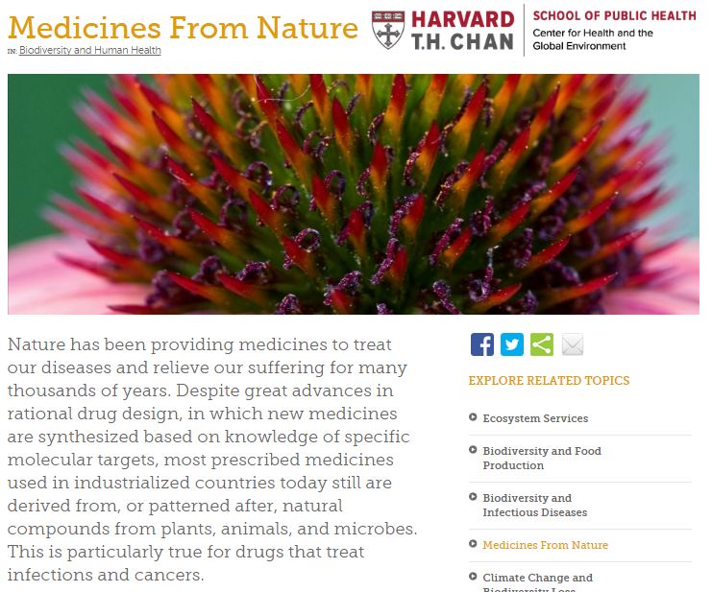
http://www.chgeharvard.org/topic/medicines-nature

Slide 11
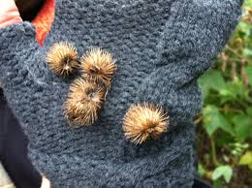
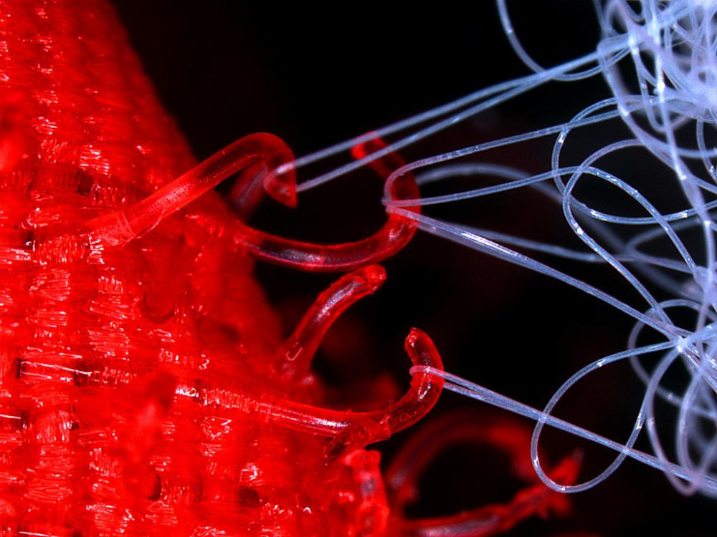
Velcro

Slide 12
Should we be concerned about biodiversity?
What we know: The Earth is losing species at an alarming rate
Some scientists estimate that as many as 3 species per hour are going extinct and 20,000 new extinctions occur each year, 1,000 times higher than previous natural “background” rates (natural, non-human).
When species of plants and animals go extinct, many other species are affected, too.
We may not know the effect of a species loss until it’s too late.
Ex. Cure to disease

Slide 13
5 Threats to biodiversity
Habitat destruction
Pollution
Invasive Species
Global Climate Change
Exploitation (pets, superstition, over-hunting/overfishing)

Slide 14
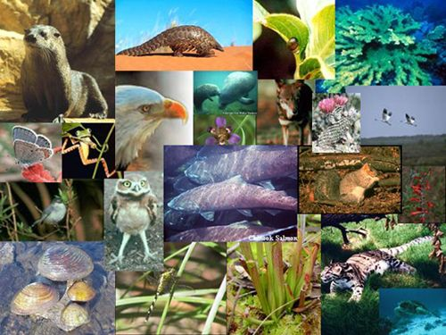
8 main Causes of Extinction
Habitat alteration 40%
Commercial hunting 23%
Competition with introduced invasive species 16%
Pest Control 7%
Subsistence food hunting 6%
Captured to serve as pets 5%
Superstitious beliefs 2%
Pollution 1%

Slide 15
Definitions
Habitat alteration: changes in an organism’s habitat such as logging, landfill, dredging, clearing for development, flooding.
Commercial hunting: hunting of animals for financial gain
Introduced/Invasive species: organisms that do not naturally live in the area
Subsistence food hunting: hunting of animals for food
Superstitious beliefs: killing of organisms to use in religious ceremonies or for scientifically unsupported superstitions (ex: killing a bear for its spleen or a rhino for its horn).

Slide 16
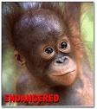
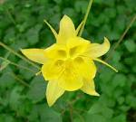
Levels of Species Risk
Step 1: Species of “special concern”
Step 2: Rare
Step 3: Threatened
Step 4: Endangered

Slide 17
Endangered Species Act
Federal program Started in 1973
Provides for the conservation (saving) of ecosystems upon which threatened and endangered species of fish, wildlife, and plants depend.
Encourages the establishment of state programs
As of October 2009, 1,361 plants and animals in the United States were listed as threatened or endangered. There are many additional species that are currently being evaluated for possible protection under the ESA, and they are called “candidate” species.

Slide 18
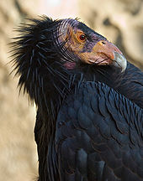
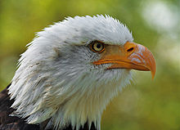
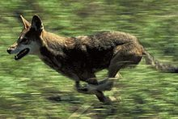
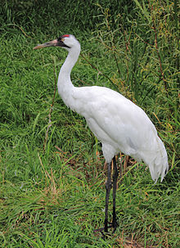
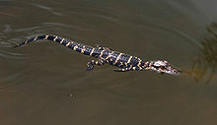
Some species brought back!
Bald Eagle California Condor
Red Wolf
Whooping Crane
American Alligator

Slide 19
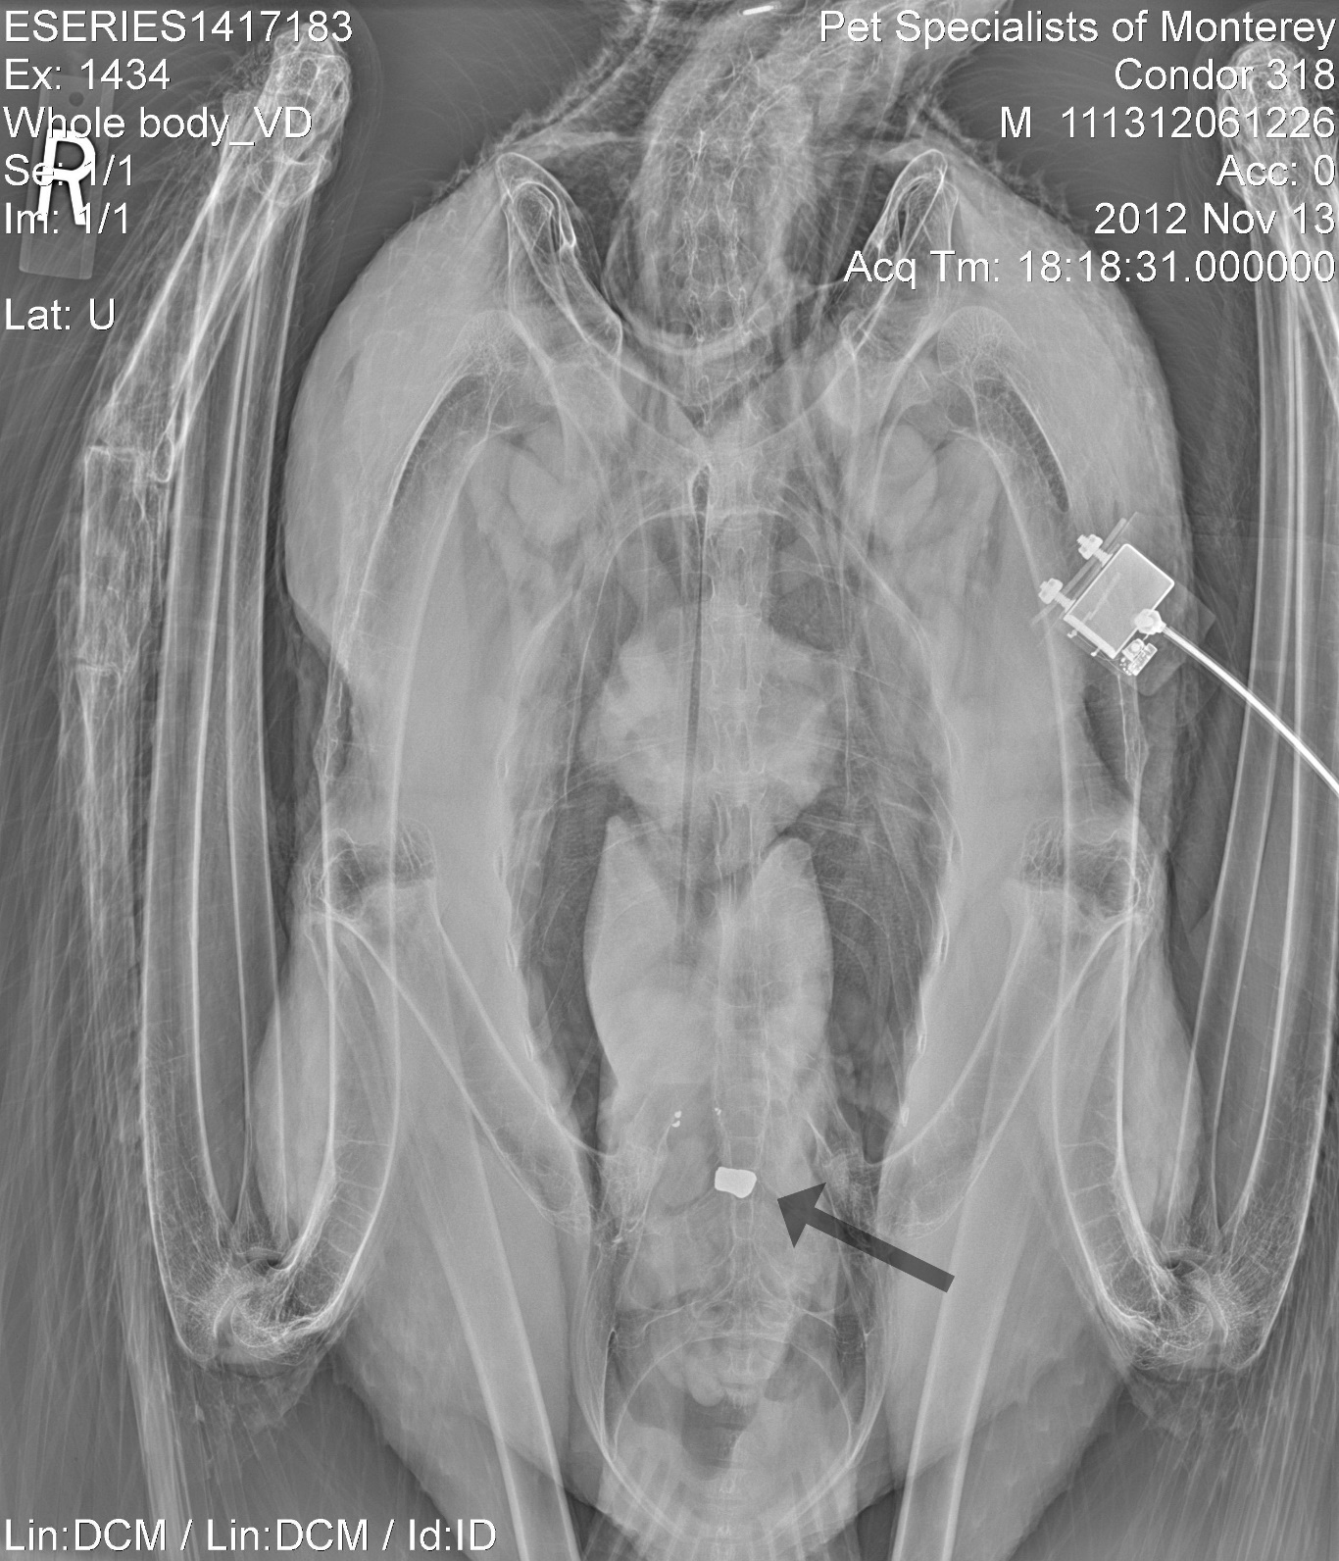

Slide 20
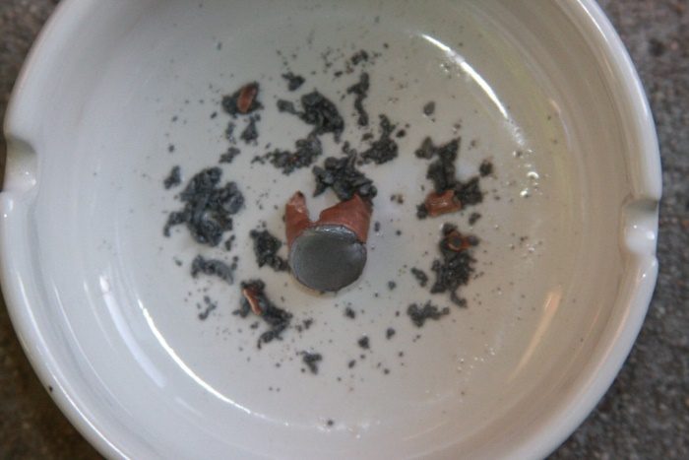
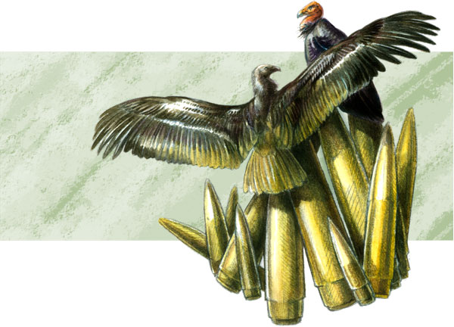
Case Study: CA Condor
Hunters would go hunting out in California
Shoot deer, etc. but not always find them
Bullet stays in animal body after death
When condor comes to scavenge the body, it eats the meat with bullet inside
Bullet kills Condors with lead poisoning

Slide 22
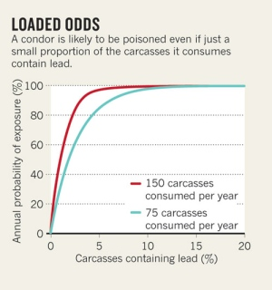
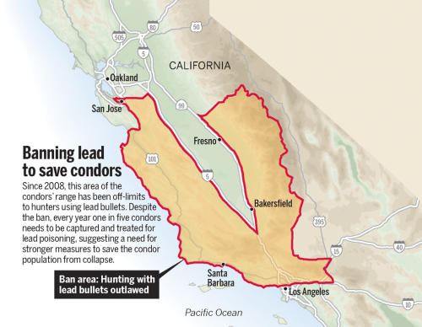
Case Study: CA Condor

Slide 23
California Condor’s Story (6min)
https://www.youtube.com/watch?v=Ct3_M0b0oKI

Slide 24
Connect the Dots: The Big Picture
What is the risk when we wait for a species to get critically endangered (condors got down to only 22 left) before we start to take action to save them and/or preserve their habitat?
Answer in 2-5 complete sentences.

