Slide 1
Notes pg#82: Keystone Species & Their Symbiotic Relationships
EQ: Why are keystone species special?
http://education.nationalgeographic.org/encyclopedia/keystone-species/

Slide 2
Set-up your page 82:
82
Notes: Keystone Species
EQ: What happens to a biome when you remove a keystone species?
Keystone Species:
Biome:_Temperate Forest
Keystone Species:_______
Why is it so important?
Biome: Desert_
Keystone Species:_______
Why is it so important?
In each box:
Biome:_________
Keystone Species:_______
Why is it so important?
Biome:Tide Pools & Coral Reef
Keystone Species:_______
Why is it so important?
Biome: Kelp Forest
Keystone Species:_______
Why is it so important?
Biome:Savannah (Grassland)
Keystone Species:_______
Why is it so important?
Q: What impact did the wolves have in Yellowstone national park?

Slide 3
You try: You are are ecosystem. What is your Keystone Species?
5 blocks per bag, Groups of 3-5 (table behind/in front of you)
Set them up so that they stand up as an arch on their own
Put the single keystone species for your biome at the top!
Use as many hands as you need to make yourselves a stable ecosystem that can support itself!
Optional: Then take your notebook and visit each arch. Write the biome name next to its keystone species if it’s on your paper.

Slide 4
“Keystone species”
Watch to
8:45

Slide 5
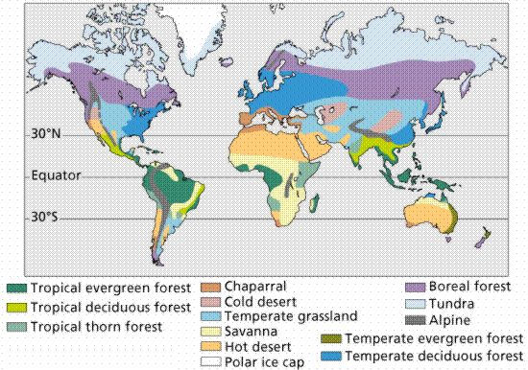
Terrestrial Biomes

Slide 6
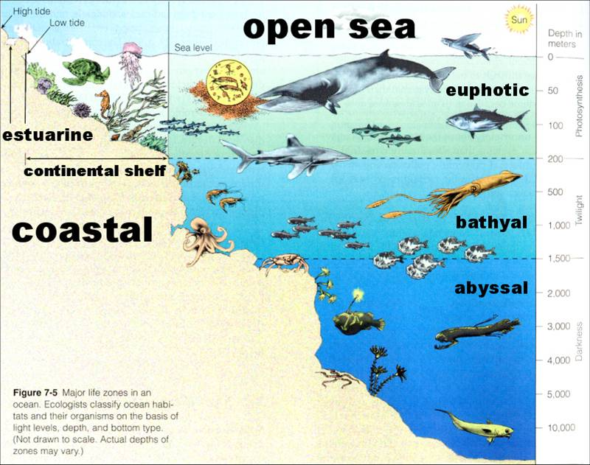
Aquatic
Biomes

Slide 7
What is a Keystone species?
A keystone species is a plant or animal that plays a unique and crucial role in the way an ecosystem functions. Without keystone species, the ecosystem would be dramatically different or cease to exist altogether.
A keystone species' disappearance would start a domino effect. Other species in the habitat would also disappear and become extinct, too. The keystone species' disappearance could affect other species that rely on it for survival (in any way- predation, mutualism, commensalism, and even parasitism).

Slide 8
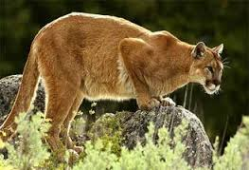
Mountain Lion (temperate Forest)
A keystone species is often, but not always, a predator. A few predators can control the distribution (spread) and population size of many prey species. A single mountain lion near the Mackenzie Mountains in Canada, for example, can roam an area of hundreds of miles. The deer, rabbits, and bird species in the ecosystem are at least partly controlled by the presence of the mountain lion through predation. Their feeding behavior, or where they choose to make their nests and burrows, are largely a reaction to the mountain lion's activity. Scavenger species, such as vultures, are also controlled by the activity of the mountain lion.

Slide 9
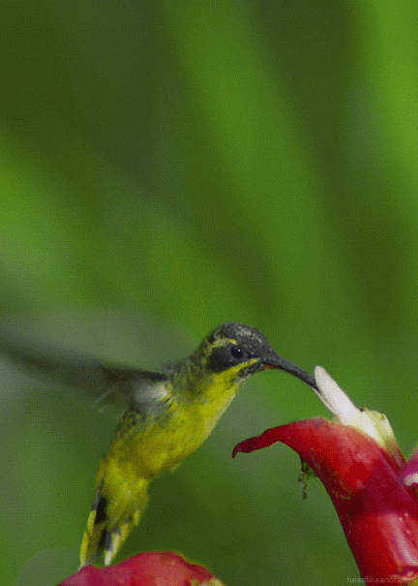
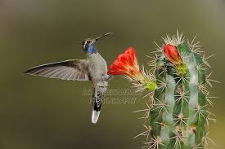
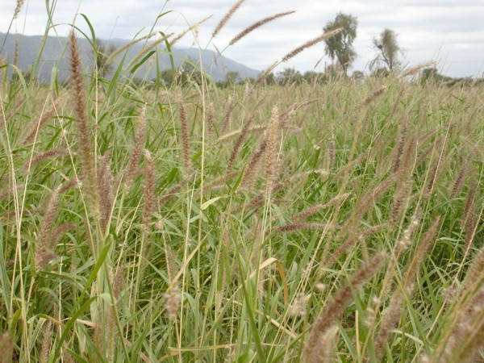
Hummingbird (Desert)
Without the keystone species, new plants or animals could also come into the habitat and push out the native species. Some species of hummingbirds are keystone species in the Sonoran Desert of North America. Hummingbirds pollinate many varieties of native cactus and other plants. In areas of the Sonoran Desert with few hummingbirds, invasive species such as buffelgrass have taken over the ecosystem.

Slide 10
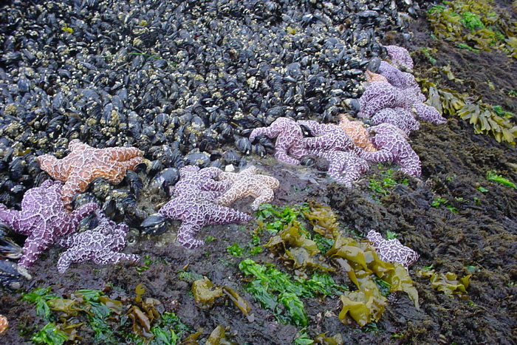
What’s going on here?

Slide 11
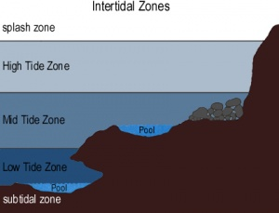
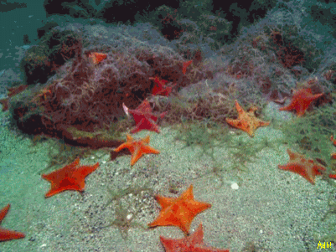
Sea Star (Tide Pools & Coral Reef)
The theory that the balance of ecosystems can rely on one keystone species was first established in 1969 by American zoology professor Robert T. Paine. Paine's research showed that removing one species, the Pisaster ochraceus sea star, from a tidal plain on Tatoosh Island in the U.S. state of Washington, had a huge effect on the surrounding ecosystem. The sea stars are a major predator for mussels on Tatoosh Island. With the sea stars gone, mussels took over the area and crowded out other species. In this ecosystem, the sea star was the keystone species.
Notes:
p6

Slide 12
They’re Keeping the mussel population in check

Slide 13
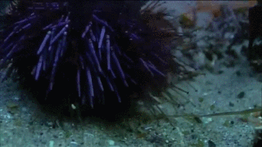
Sea Otter (Kelp Forest)
The sea otter is another example of a keystone species in the Pacific Northwest. These mammals feed on sea urchins, controlling their population. If the otters didn't eat the urchins, the urchins would eat up all the habitat's kelp. Kelp, or giant seaweed, is a major source of food and shelter for the ecosystem. Some species of crabs, snails, and geese depend on kelp for food. Many types of fish use the huge kelp forests to hide from predators. Without sea otters to control the urchin population, the entire ecosystem would collapse.

Slide 14
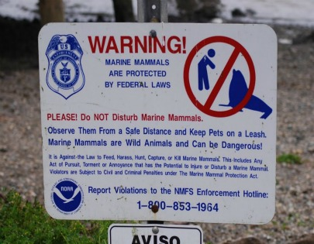
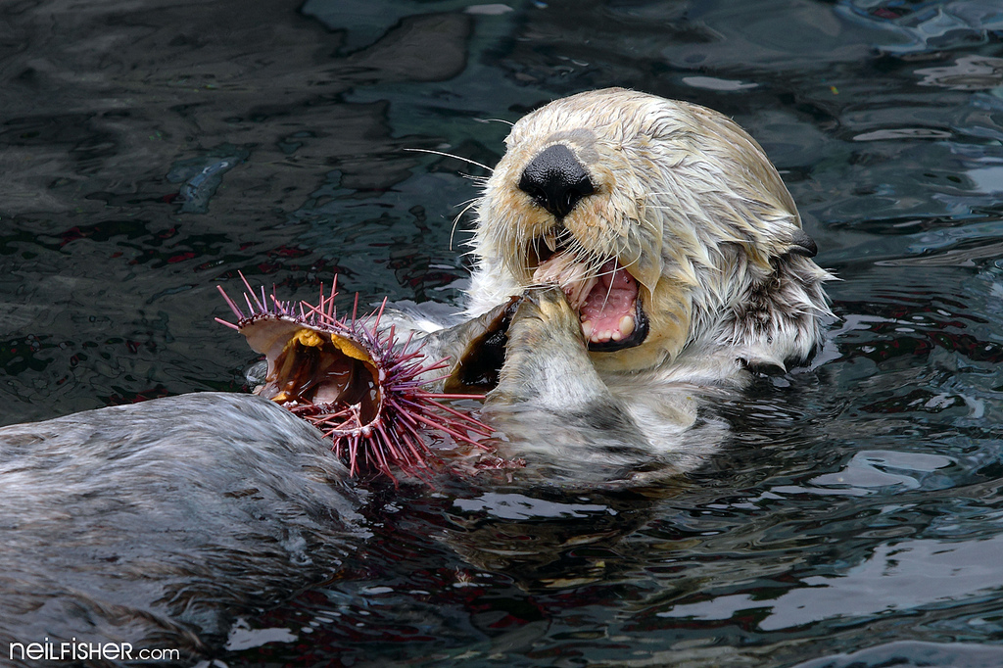

Slide 15
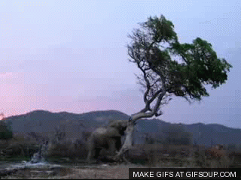
What’s this elephant doing & why?

Slide 16
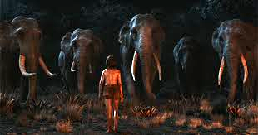
Elephant (Savanna)
Herbivores can also be keystone species. In African savannas such as the Serengeti plains in Tanzania, elephants are a keystone species. Elephants eat small trees, such as acacia, that grow on the savanna. Even if an acacia tree grows to a height of several feet, elephants are able to knock over the tree and uproot it. This feeding behavior keeps the savanna a grassland and not a forest or woodland.
With elephants to control the tree population, grasses thrive and sustain grazing animals such as antelopes, wildebeests, and zebras.
Smaller animals such as mice and shrews are able to burrow in the warm, dry soil of a savanna.
Predators such as lions and hyenas depend on the open savanna for prey. Elephants are the keystone species that maintain the entire savanna ecosystem.
Notes:
p1

Slide 17
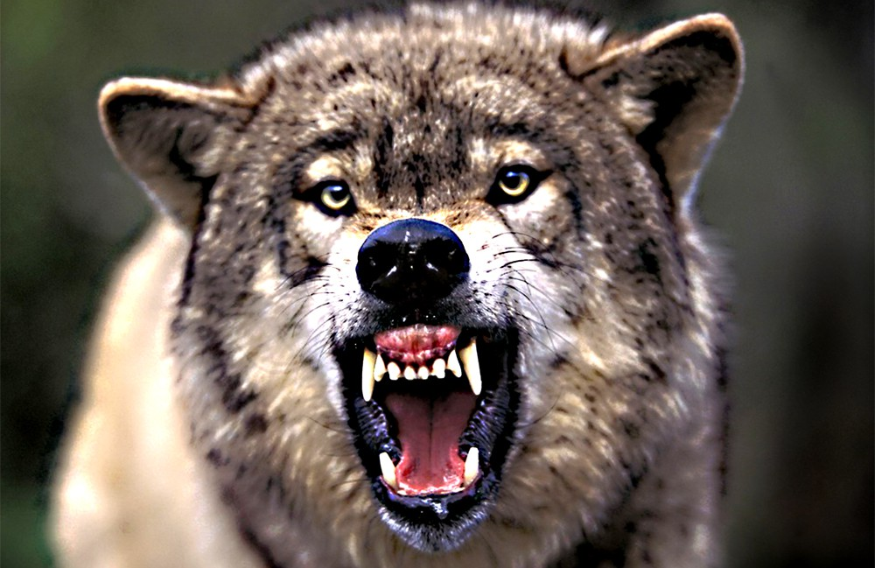
In summary...
Removing any one species, but especially a keystone species, will have multiple effects on that habitat’s balance- even if we do not think an animal is “cute” or “important.” ex. Wolves

Slide 18
Can you solve the mystery?
Many animals live in Yellowstone National Park. A long time ago, the gray wolf was one of those animals. The gray wolf is a predator that kills smaller animals for its food, but many people didn’t like having gray wolves around. People trapped and hunted gray wolves to keep them from killing their sheep and cattle. The gray wolves were completely removed from Yellowstone National Park by the 1920s. The people were happy- no more wolves on their land or eating the innocent elk.
As the years passed, scientists noticed distressing changes in Yellowstone National Park. Some kinds of trees, such as aspens, seemed to be dying out. But why?

Slide 19
Wolves in Yellowstone:
Before: Watch the 5min video:
http://www.pbslearningmedia.org/resource/a58e3ca2-52ab-45f5-87ac-26ee0d681146/wolves-of-yellowstone-earth-a-new-wild/en/
(also available with spanish dubs)

Slide 20
After: Ecology menu time
4:30min

Slide 21
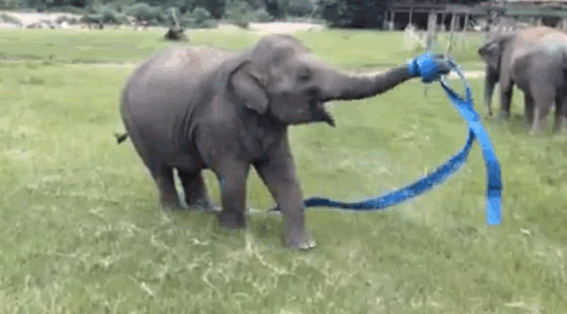
That’s all, folks!
Not you know what a keystone species is and why they’re so important to their habitat, ecosystem & biome- even if we humans don’t realize how they’re important- the biome is in balance.

Slide 22
P1 Exit Ticket
How was a lack of wolves affecting the tree population in Yellowstone National Park?
Give one example of a keystone species and how it maintains balance in its biome.
How is a keystone species the “glue” that holds everyone who lives in its biome together?

