Slide 1
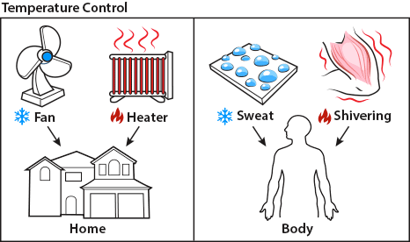
Homeostasis Notes
pg. 29
The Nervous System & Homeostasis

Slide 2
(controlled by Nervous System)
(controlled by Excretory System)
(controlled by Excretory System)
(controlled by Excretory System)
(controlled by Digestive System)

Slide 3
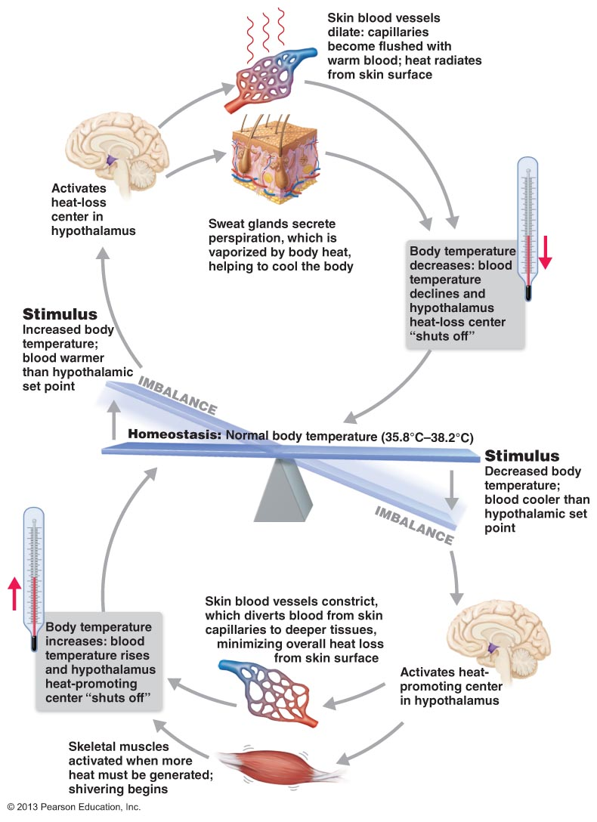
Homeostasis = Regulating internal environment

Slide 4
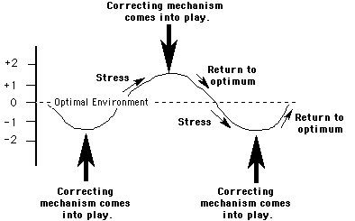
Controlled through feedback loops

Slide 5
What does feedback mean?

Slide 6
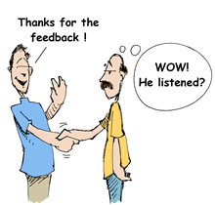
Feedback is...
The changing of a system in response to measuring the effects of that system.
Ex: I asked you after Friday’s test how you felt about it- so I know for next test if we need to study more, etc.
Ex: Taking a survey after visiting a business, they want to know how your experience was to know if it’s going well or to make it better

Slide 7
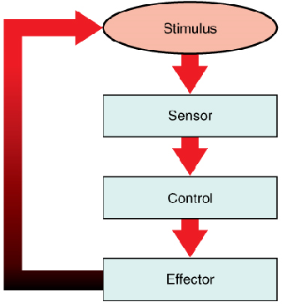
It’s called a Feedback loop
Event: You went into a business & had a typical experience
Later took the Survey on the bottom of the receipt
Boss reads survey and decides what to do next
Boss tells employees what to change & they do it
S e t
P o i n t
Notes:
P1

Slide 8
Pass out table to fill in!

Slide 9
NS: Temperature 2 feedback loops ws pg.30

Slide 10
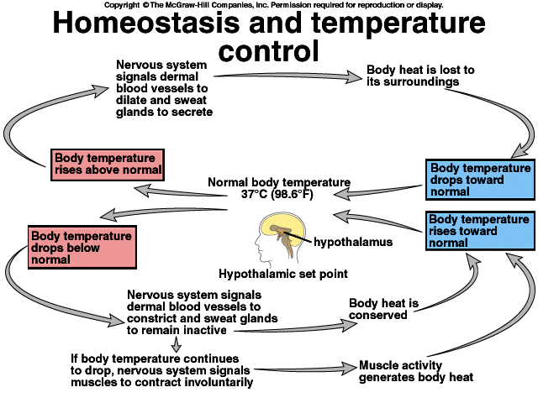

Slide 11
Get a table, tape over your notes as a flap on pg.29 when done today

Slide 12
Let’s fill in the table together for a thermostat

Slide 13
Use your diagram to fill in the table for human body

Slide 14
For a feedback loop you need:
Set-point: Knowledge of what is “normal” (ex: human internal body temperature of 98.6ºF/37ºC)
Stimulus: A change must occur away from the set-point
Sensor: Constantly checking/ looking for a change (ex: Nerves in skin)
Control Center: to decide what to do to fix the change (ex: Brain)
Effector: An organ, etc. that can receive instructions from brain and can physically cause a change (ex: muscles shiver, pancreas release sugar into the blood if haven’t eaten in awhile)
Control center stops effector once change has been neutralized/returned to set-point (ex: no longer cold, stop shivering)

Slide 15
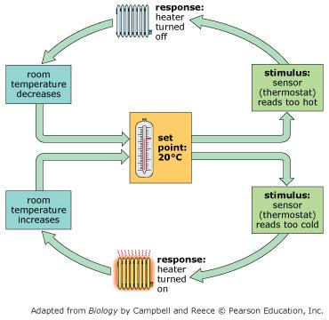
In a house:
Stimulus: temperature change
Sensor: Thermostat takes temperature 24/7 to watch for change
Control Center: Chip in thermostat is programmed how to turn on heater if cold/AC if hot.
Effector: Heater/AC (outside) physically changes the temperature until the control center says the house is back to normal set temperature.

Slide 16
In a body:
Stimulus: internal temperature change- TOO COLD
Sensor: Hypothalamus in brain takes temperature 24/7 to watch for change
Control Center: Hypothalamus uses the release of hormones into the blood to control our response.
Effector: Hormone messengers turn on or off several changes that affect body temperature until the hypothalamus says the body is back to the set point temperature
shiver/sweat, goosebumps, constrict blood vessels, lower circulation to hands and feet...

Slide 17
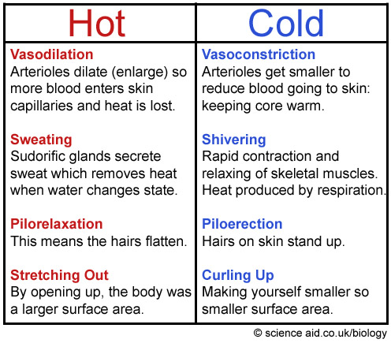
The body does more than just sweat or shiver in response to temperature change

Slide 18
Think about:
What are the 4 steps in the sweating example?
Stimulus?
Sensor?
Control?
Effector?
2min

Slide 19
Other cool animal adaptations for temperature regulation
4min
Thermoregulation

Slide 20
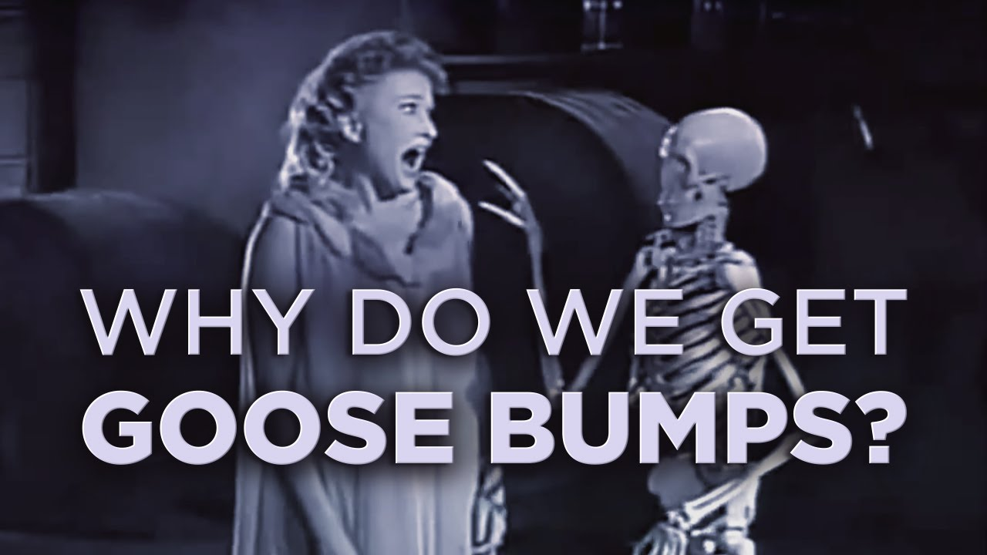

Slide 21
Vocabulary:
Physiological = in your body

Slide 22
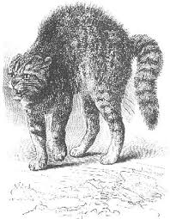
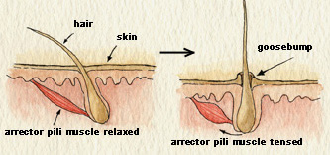
Goosebumps
Vestigial (left-over) trait from when our ancestors had more hair to hold up and to make a difference in holding air to increase body temperature.

Slide 23
Feedback Loop #2: Stress Response pg31

Slide 24
Day 2 Notes:
2 Types of Feedback Loops pg.32

Slide 25
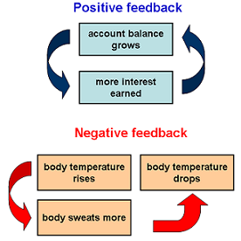
Feedback Loops: 2 Types
Positive (+) Negative (-)
When a change causes a greater increase (gets amplified- leaves homeostasis) [++]
Unsustainable
Ex: Stress
When a change is corrected (gets put back to normal) [+- or --]
Sustainable
Ex: Body Temp
Q: Which type do you think most feedback loops in your body are?

Slide 26
Example
or - or no loop?
Copy on your notes!
Smiling
Mood
+
+

Slide 27
Practice
Copy on your notes!
or - or no loop?
Liking math
Math performance
+
+

Slide 28
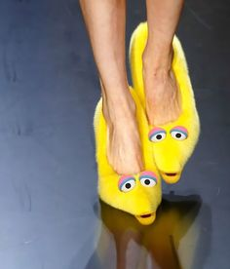
Practice
Copy on your notes!
or - or no loop?
People say they don’t like your shoes
Times you wear those shoes
-
+

Slide 29
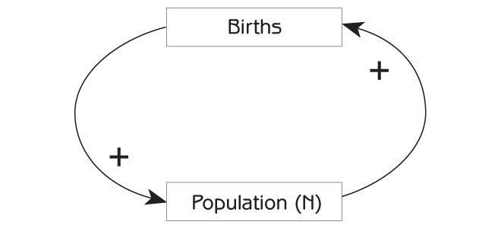
Practice
Copy on your notes!
or - or no loop?

Slide 30
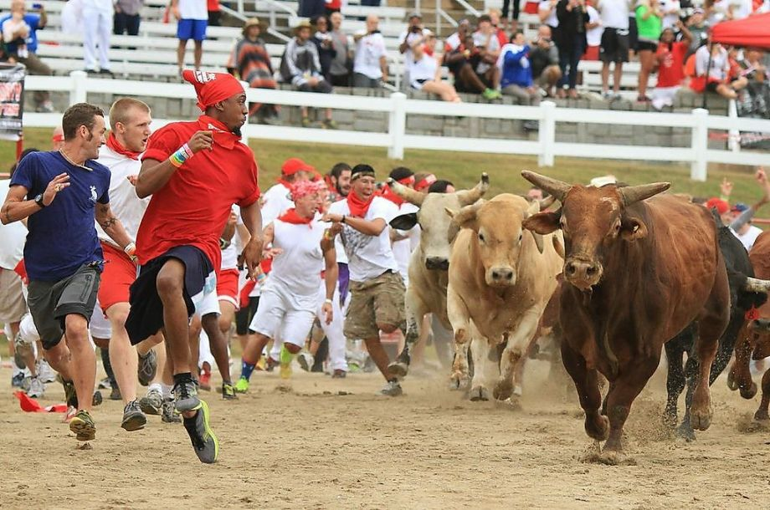
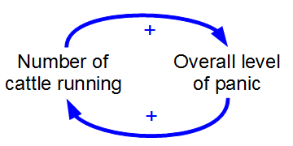
Practice
Copy on your notes!
or - or no loop?

Slide 31
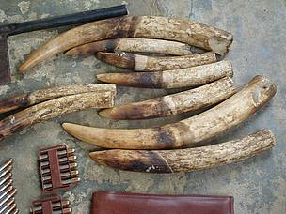
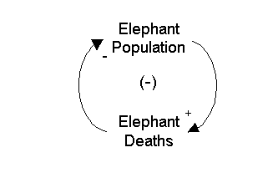
Practice
Copy on your notes!
or - or no loop?

Slide 32
Practice
or - or no loop?
Amount of studying
Grades
+
+

Slide 33
Practice
or - or no loop?
Temperature
Sweating
+
X

Slide 34
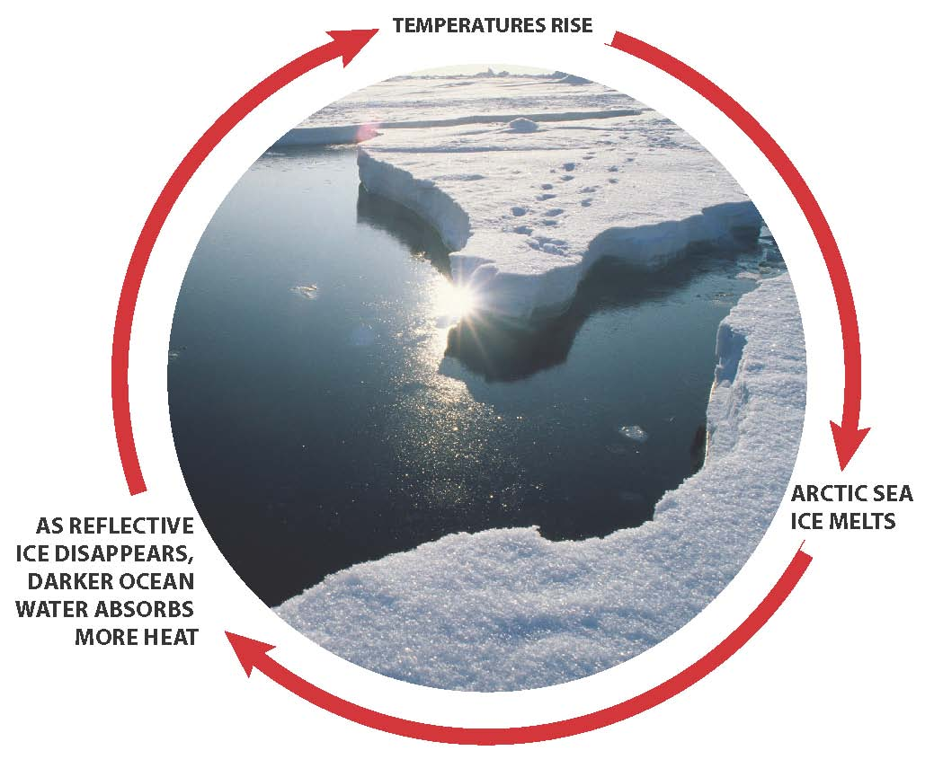
Practice
+
+
or - ?
+
+

Slide 35
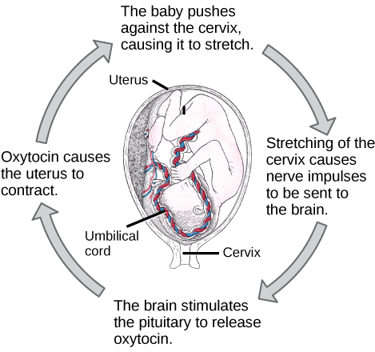
Practice
or - or no loop?
+

Slide 36
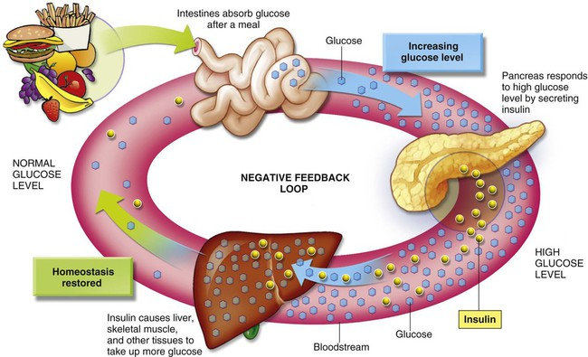
Blood Sugar

Slide 37
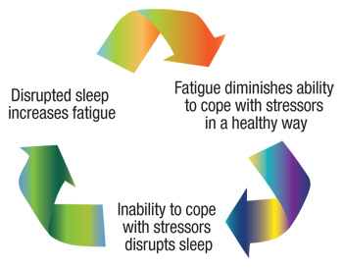
Practice
or - or no loop?
-

Slide 38
Practice
Blood clotting: Once a vessel is damaged like by a cut or bruise, platelets start to cling to the injured site and release chemicals that attract more platelets. The platelets continue to pile up and release chemicals until a clot is formed.
or - ?
Notes:
+

Slide 39
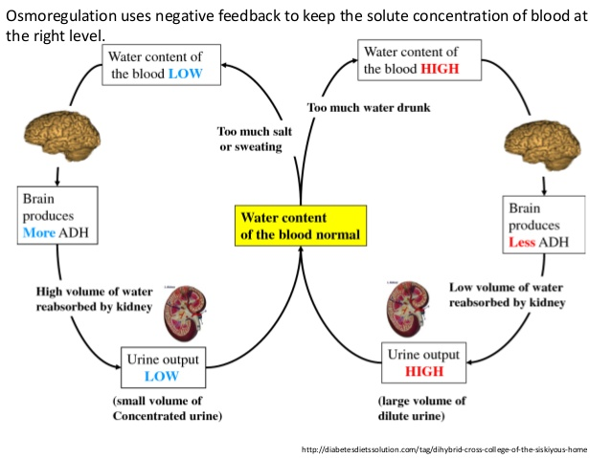
Practice
or - ?

Slide 40
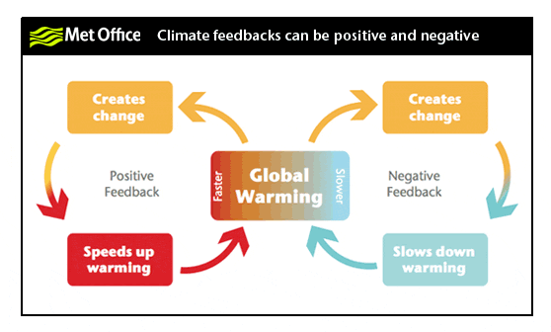
Double Example

Slide 41
What happens if a feedback loop can’t be completed?
Can you think of an example?

Slide 42
Diabetes
When the body doesn’t make enough of the hormone insulin (effector) to return your blood sugar levels back to the set-point after you eat.

Slide 43
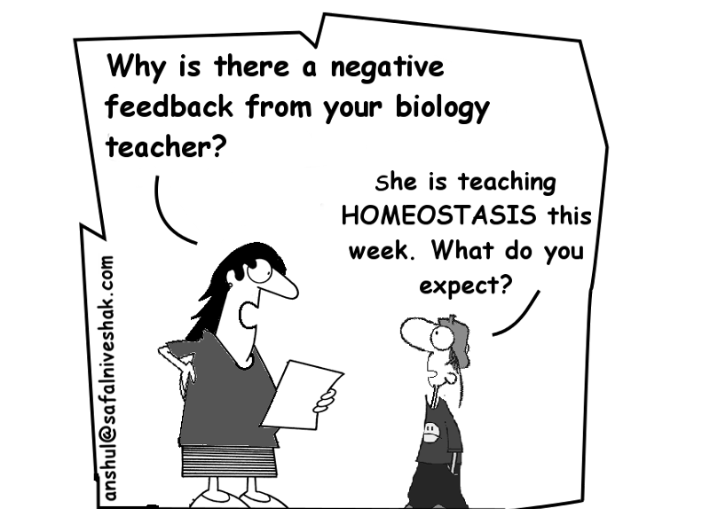

Slide 45
2 FACTS
CAN YOU DIE FROM TOO MUCH OXYGEN?

Slide 46
Fill out foldable pg.27
Use your notes

Slide 47
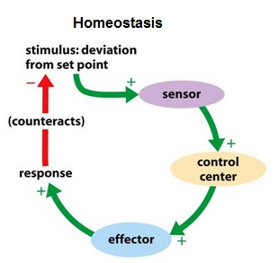
A Delicate Balancing Act- a cycle/loop
The body uses negative feedback loops to maintain homeostasis (balance)
And less often uses positive feedback loops in more special circumstances (ex: fear, giving birth, blood clotting after cut, etc.)
Fill in your diagram

Slide 48
Answer during the video:
1. What is the average human body temperature?
2. How do many antibiotic medicines kill bacteria?

Slide 49
Video Recap
What is the average human body temperature?
2. How do many antibiotic medicines kill bacteria?

Slide 52
HONORS warm-up: Friday
Explain the difference between positive and negative feedback.
Then identify the following diagrams as positive or negative feedback systems:
1)

Slide 53
HONORS warm-up: Friday
Explain the difference between positive and negative feedback.
Then identify the following diagrams as positive or negative feedback systems:
2)

Slide 54
PBS Interactive
Homeostasis in several Human Body Systems

Slide 55
PBS Interactive on Homeostasis
Answer the pre-lab questions on your lab
Go to the link on the top of your handout
Answer the Discussion Questions
Turn in!
http://www.pbslearningmedia.org/resource/tdc02.sci.life.reg.bodycontrol/body-control-center/

Slide 56
Reflex Lab: Ruler Drop Test
pg. 26

Slide 57
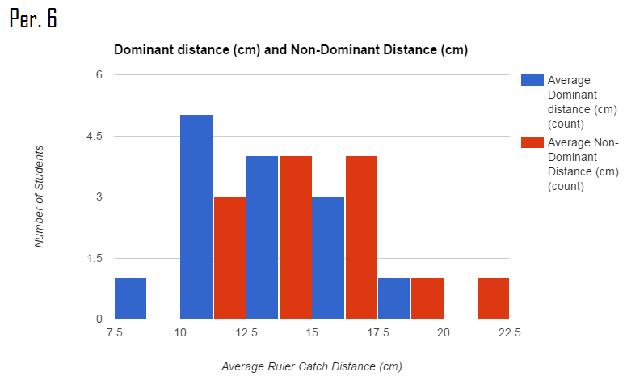
Warm-up: This is visual test data from yesterday’s ruler reflex lab. What does this graph tell you? Make sure you read the axis labels and the legend (color-key):

Slide 58
Reflex Lab Results
The result should have showed that the time in response to the tactile stimuli was significantly shorter, followed by the auditory stimuli and then the visual stimuli.
You become aware of auditory stimulation sooner than visual because Visual information is heavily, heavily processed.
Ex: Information has to travel through many more neurons before it starts reaching conscious parts of your brain.
It takes auditory stimuli 0.08-0.1 seconds to reach the brain while visual stimulus take 0.2-0.4 seconds to reach the brain. (http://biae.clemson.edu/bpc/bp/Lab/110/reaction.htm).
BUT Factors like age, gender, education level, time spent on computer, left/right finger had significant effects on the response time of an individual to visual and auditory stimuli.
Females were found to respond faster than males.
If we had tested it, smell is the fastest because it skips the thalamus.
Notes:
http://www.iaeng.org/publication/IMECS2012/IMECS2012_pp1449-1454.pdf

Slide 59
Skeletal System & Muscular System
Webquest on Muscular System & Homeostasis

